Slide 1

CASE STUDY Maidstone and Tunbridge Wells NHS Trust
Rapid Access Point ward,
“in duct ” UVC air sanitisation upgrade
2021.

Slide 2
Maidstone hospital RAPS ward
To stop ambulance queuing. Some hospital had 25 + ambulances waiting.
To reduce infection risk
To protect staff
To safeguard patients
Reduce energy usage
Reduce carbon emissions

Slide 3
IN DUCT UVC SANITISATION
UVC to kill germs since 1887.
UVC for water disinfection.
UVC for air disinfection
Install UVC into existing and new HVAC systems.
Use wheel in ‘mobiles’ for immediate use

Slide 4
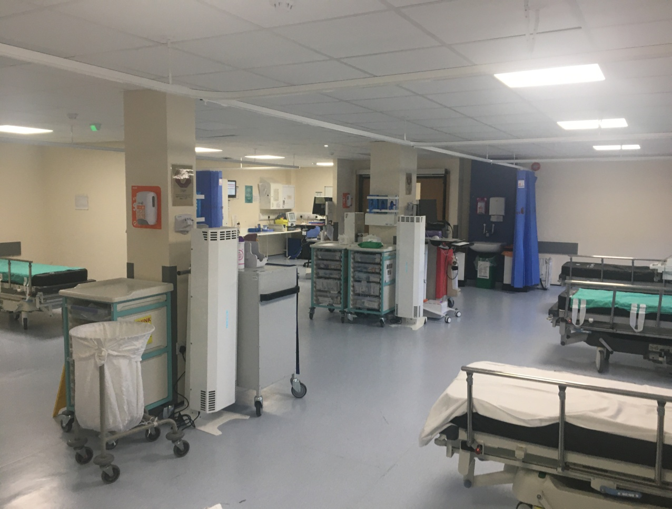
Rapid Access Point (RAPs) ward

Slide 5
SCHEME OUTLINE
Existing HVAC provides heating , cooling and fresh air.
New upgrade system provides heating , cooling, fresh air and ‘clean’ air
UVC section installed in return duct, capable of giving a 4 log reduction to Inf. A viruses.
Meets and exceeds NHS spec HTM 03 Ventilation

Slide 6
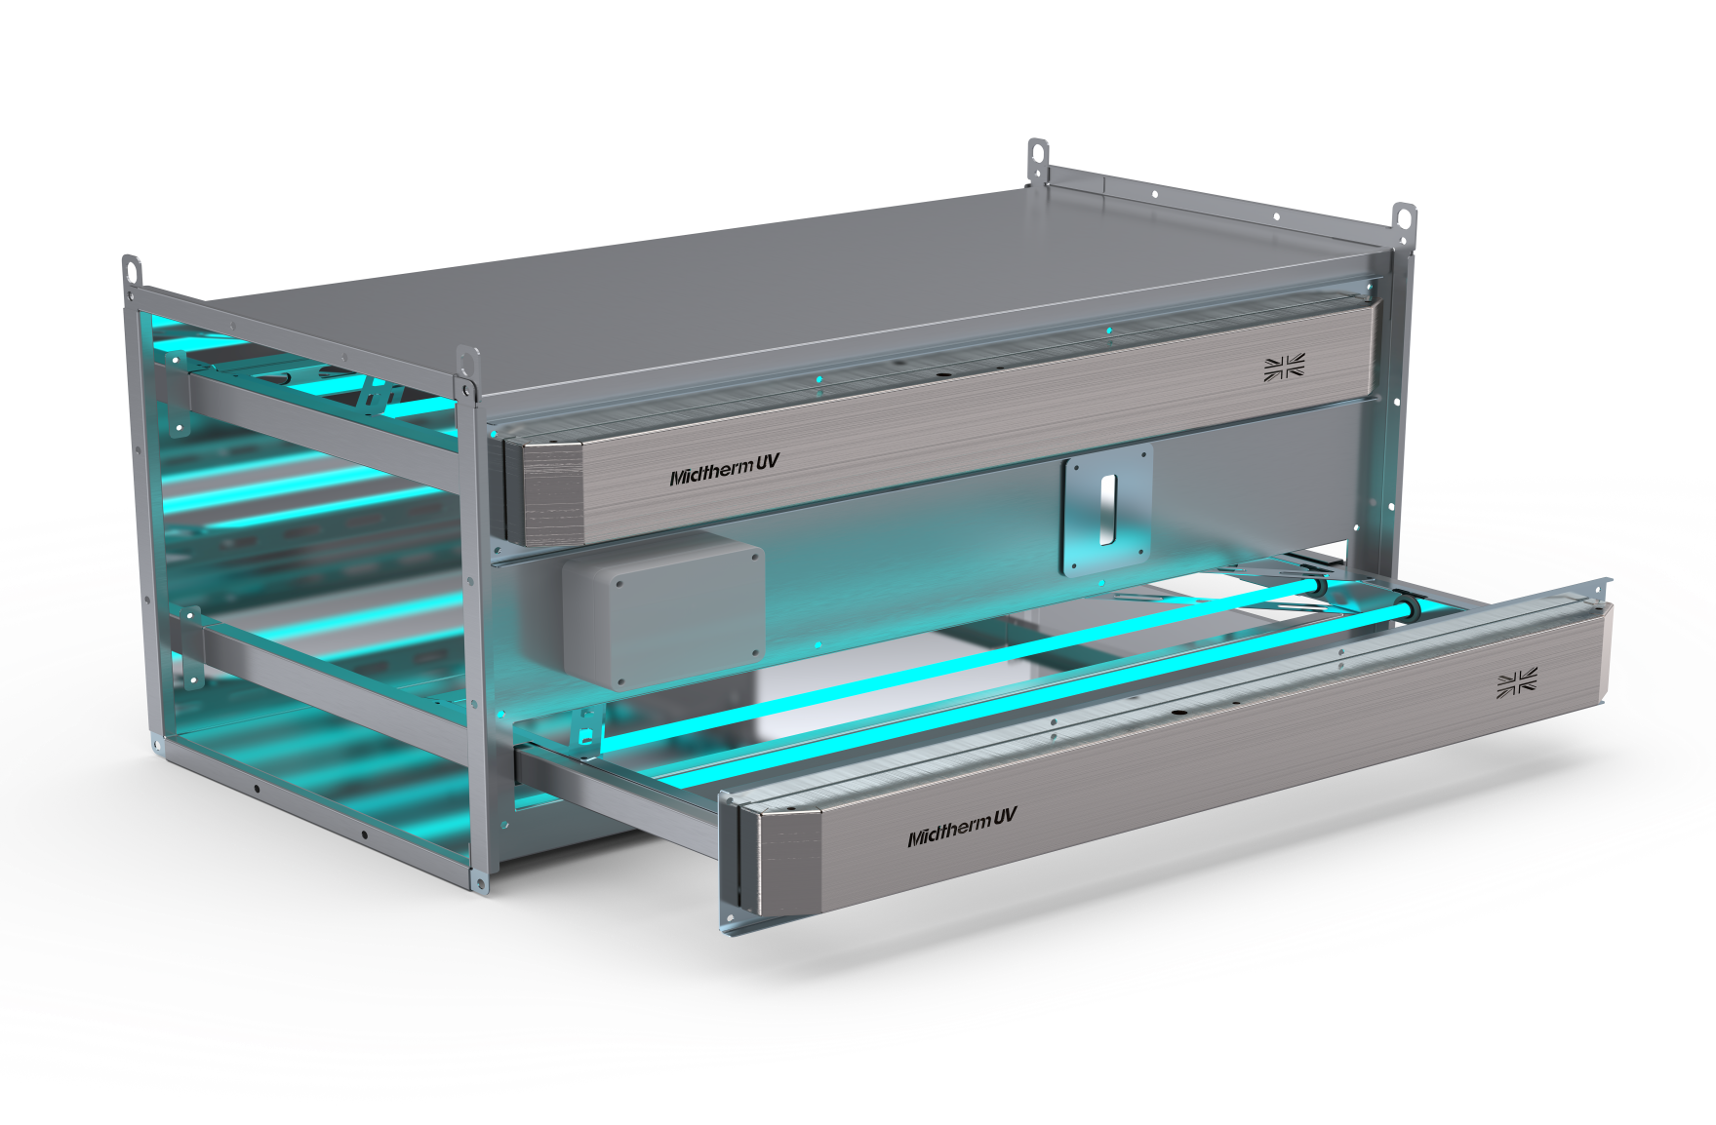
1,800 m³/h UVC duct unit

Slide 7
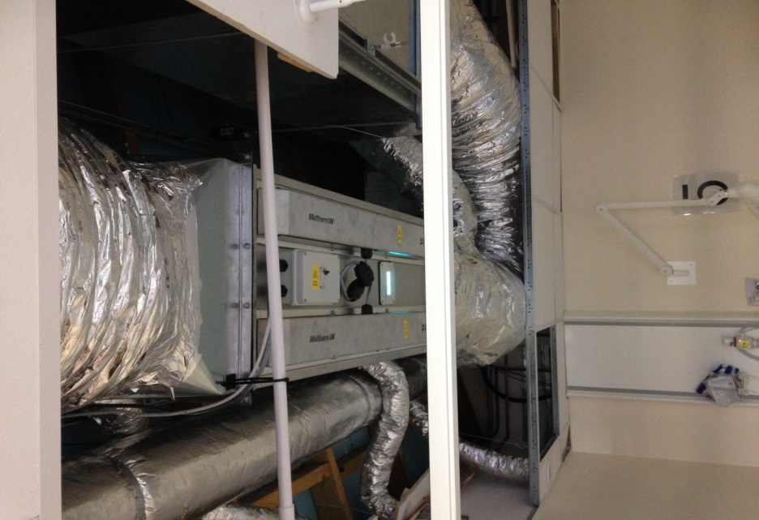
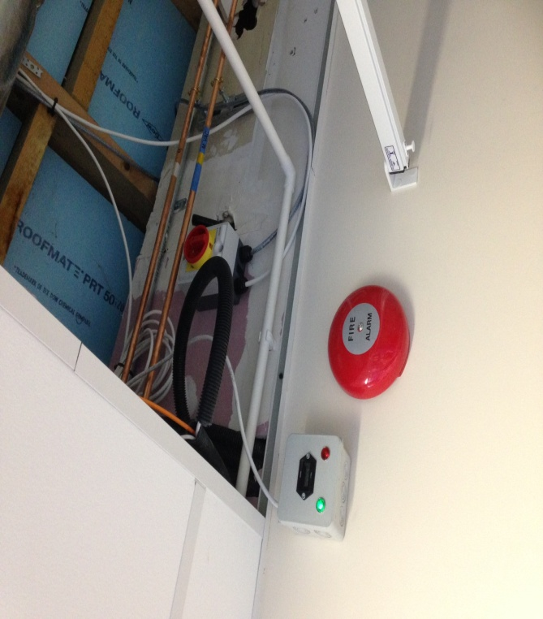
New duct unit in place above the ceiling tiles & local alarm indication/ hours run meter.

Slide 8
TEST METHOD
Air sampling.
UKAS lab analysis.
First air tests carried out without UVC.
Next air tests carried out with mobile UVC units
Final air tests carried out with new in duct UVC

Slide 9
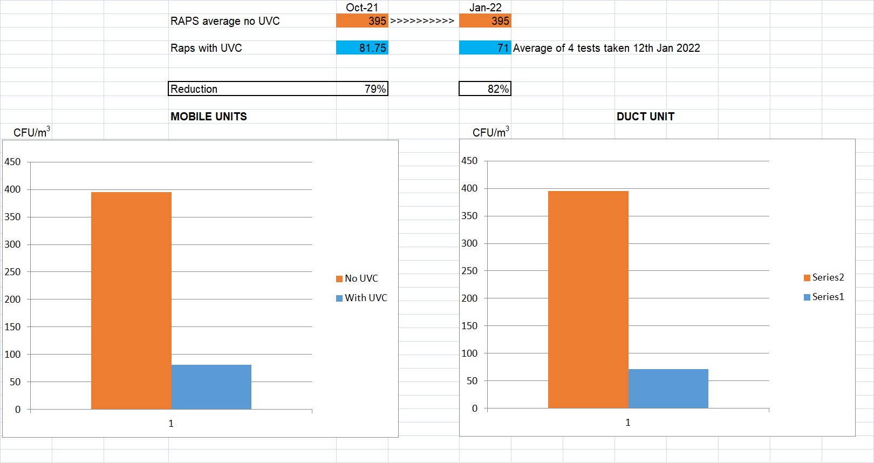
AIR TEST RESULTS

Slide 10
KEY RESULT
80 % reduction in airborne pathogens.

Slide 11
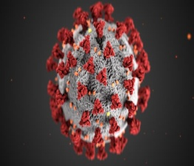
Benefits of UVC
By installing UVC many benefits accrue
Reduced airborne pathogens
tCO₂e
Reduced carbon emissions help meet Nett zero targets.
.
uvc
Lower HCAI’s
Improves IAQ through better ”ventilation effects”.
Reduced costs, £2bn achievable, healthier staff.
£

Slide 12
KEY BENEFITS
Hospital productivity - Reduced staff absenteeism, reduced waiting lists, patient service
Low costs to upgrade - quick paybacks.
Reduction in Carbon emissions. If rolled out across NHS = 200,000 CO₂eq tpa , 33% of Net Zero target.
Increased productivity in offices due to lower illness rates. Saving £billions ???

Slide 13
THE WAY FORWARD
Install UVC into existing HVAC duct systems to bring hospitals up to standrad HTM 03
Install stand alone UVC HVAC duct systems, on a ward scale, to give fast improvements to sites without compliant ventilation systems.
Include UVC and recirc HVAC into all new Hospitals to achieve NZ

